Slide 1


OUR TEAM
TEAM LEADER
PRATHIBA S
TEAM MEMBERS
POOJA E
RASHIKA S
SHAHRUKH KHAN B
KEERTHANA N

Slide 2
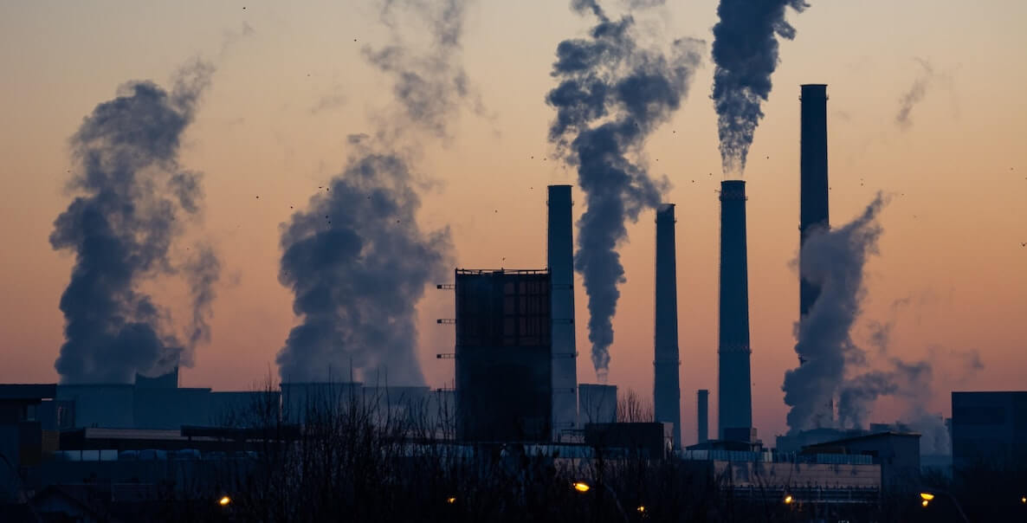


AIR QUALITY
ANALYSIS

Slide 3
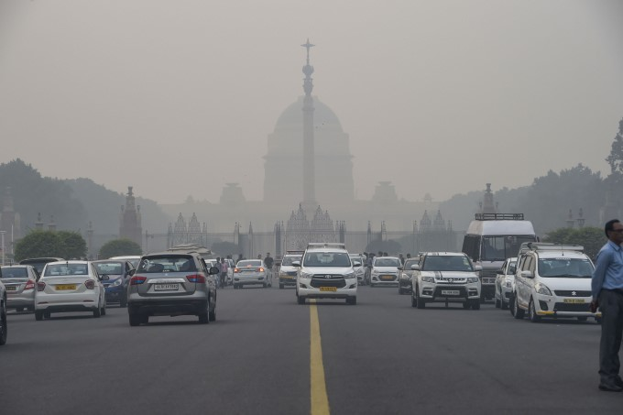
INTRODUCTION
Air quality refers to the degree to which the air is suitable for clean enough for humans or the environment.

Slide 4
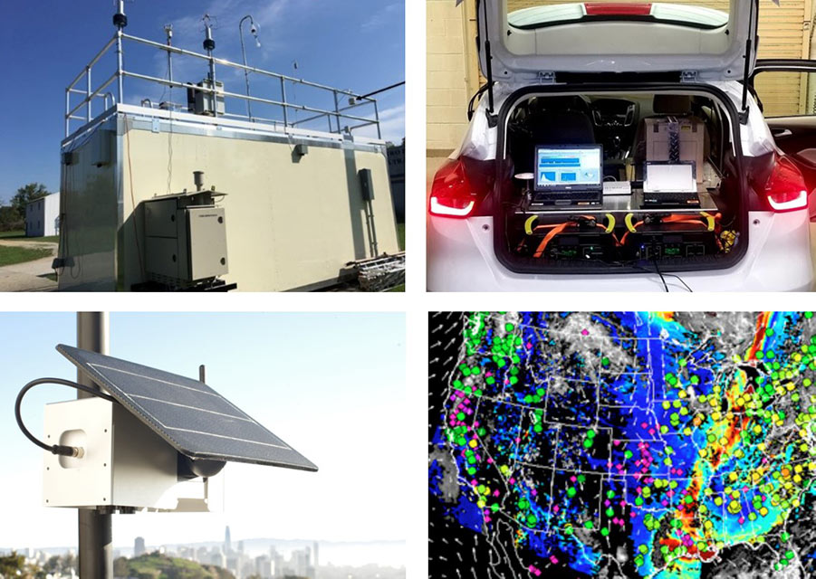
DATA COLLECTION
Data on air quality is
Collected through a
Network monitoring stations equipped with Sensors and instruments that measure the pollutant concentration

Slide 5
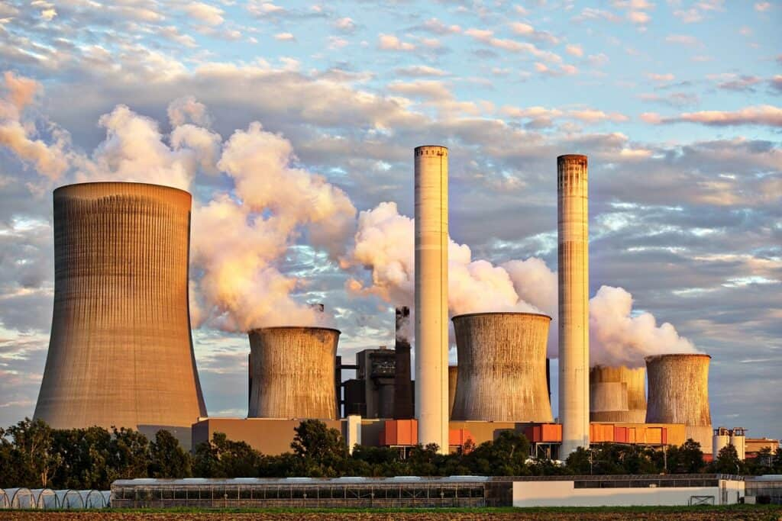
Sources of air
pollutants
Traffic
Mobility
Industry
Heating
Agriculture
Green house gases
Deforestation

Slide 6
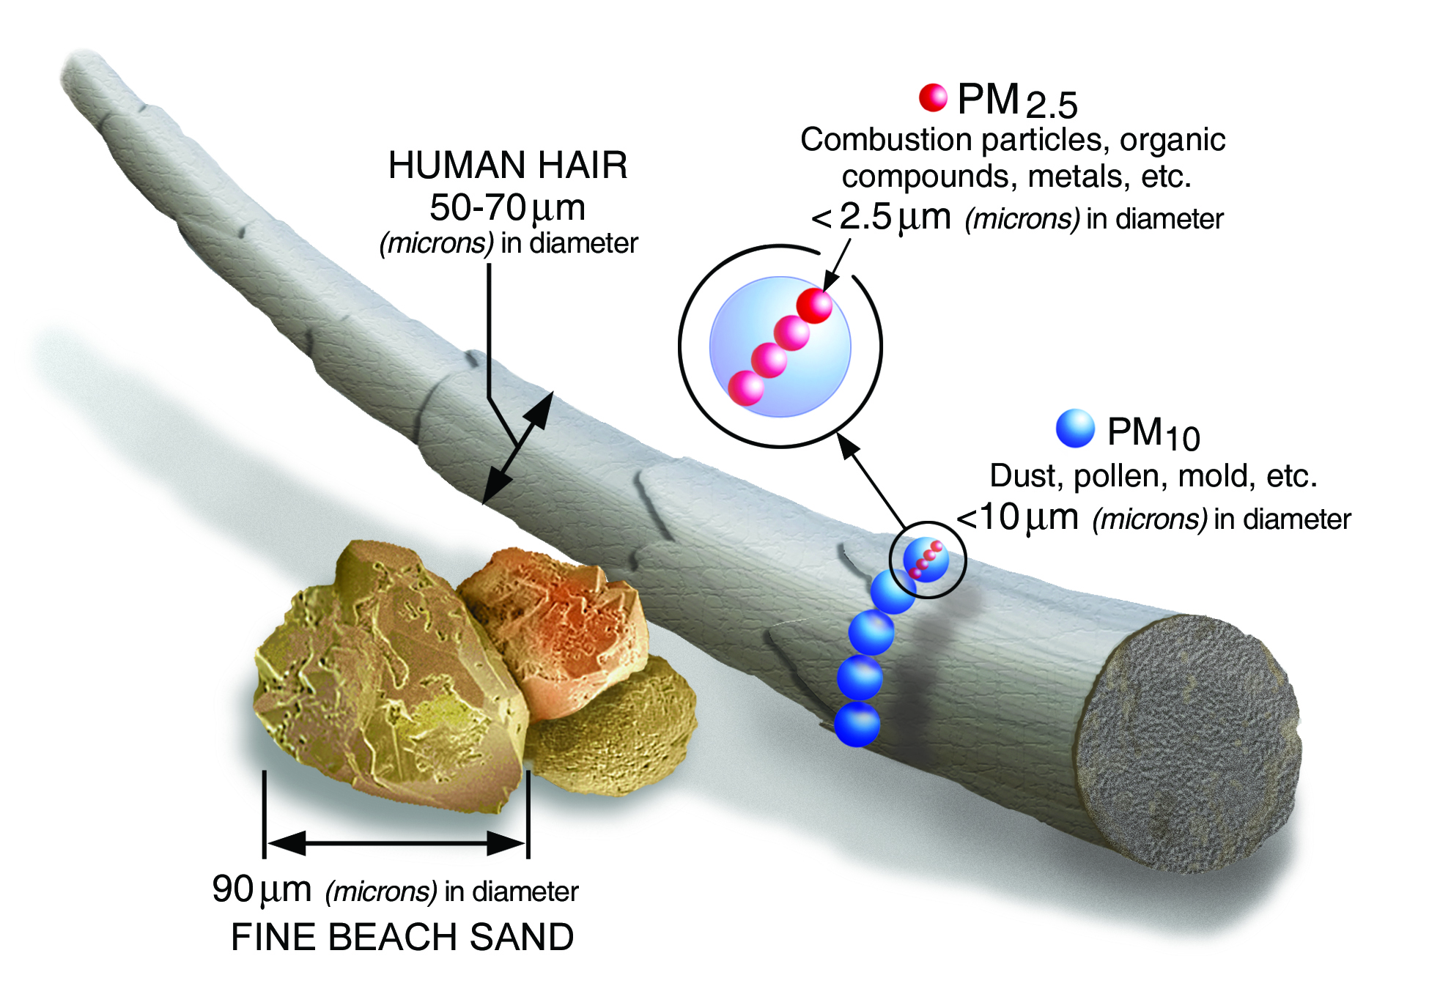
DATA ANALYSIS
Air quality data is analyzed to assess trends, patterns, and potential health or environmental impacts. Data analysis may involve statistical techniques, data visualization, and modeling to predict future air quality conditions.

Slide 7
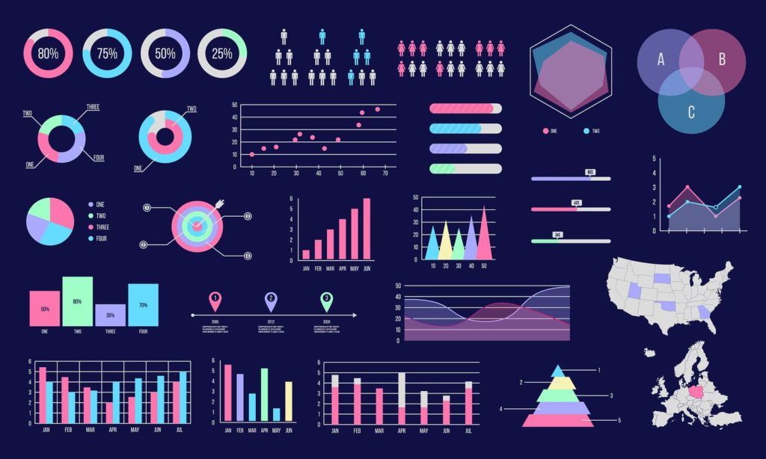
data visualization
Data visualization is the representation of data through use of common graphics, such as charts, plots and even animations. These visual displays of information communicate complex data relationships and data-driven insights in a way that is easy to understand.

Slide 8
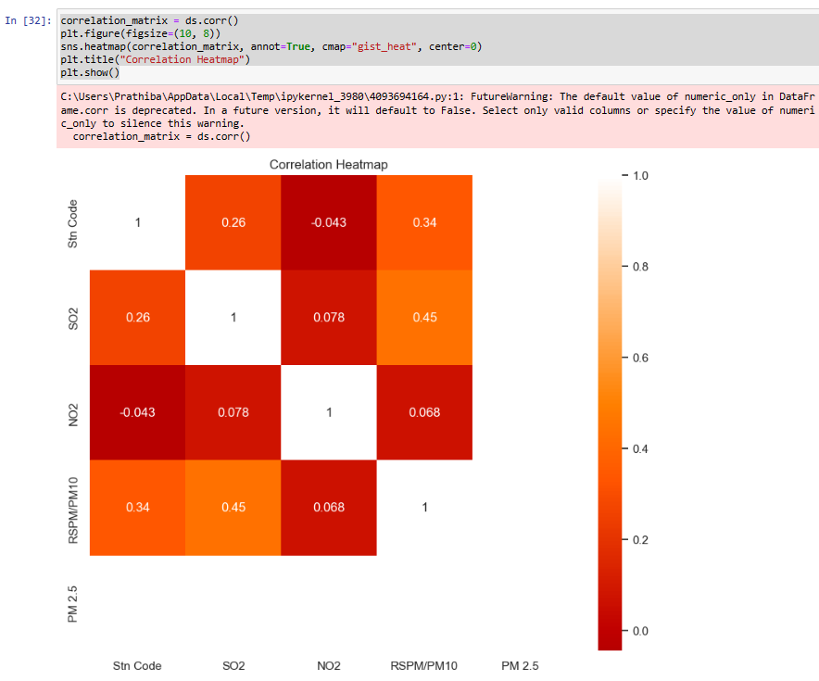
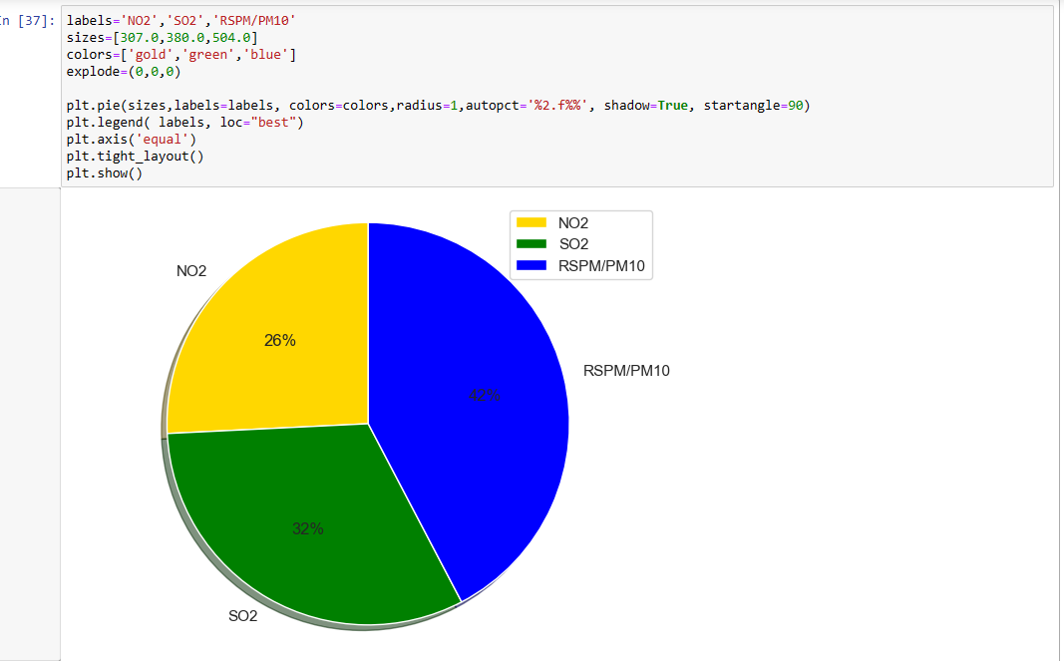

Slide 9
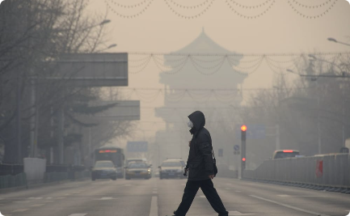
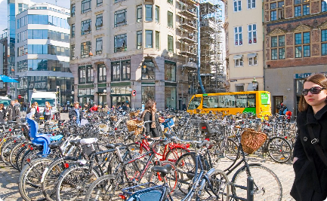
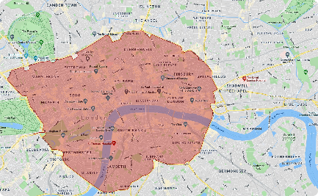
Case study examples
CHINA DENMARK LONDON

Slide 10
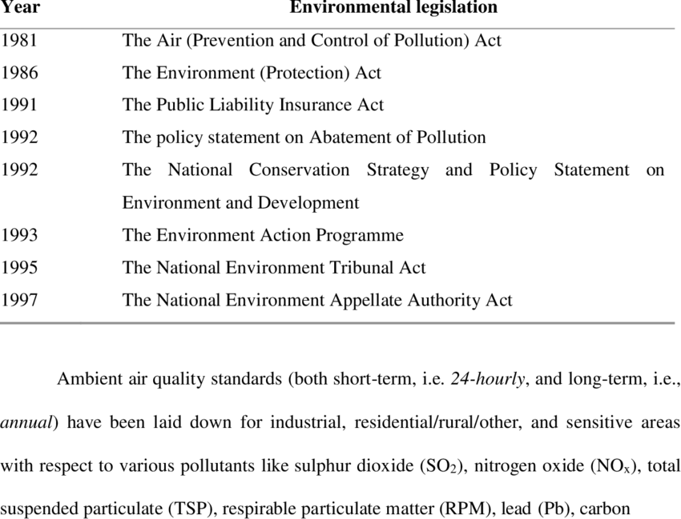
POLICY AND REGULATIONS

Slide 11

CONCLUSION
Air quality is a complex issue that requires a multi-faceted approach. By raising awareness, implementing policies, and making individual choices, we can work together to improve air quality and protect public health.

